Slide 1
Automation script
Rounak Kalbhawar

Slide 2
AGENDA
Introduction​
Design
Proof of functionality
​Summary​

Slide 3
Introduction
The main purpose of the automation script is to make the lives of the employees easier by automatically updating the data present in the excel sheet into the power-point presentation.

Slide 4
Design

Slide 5
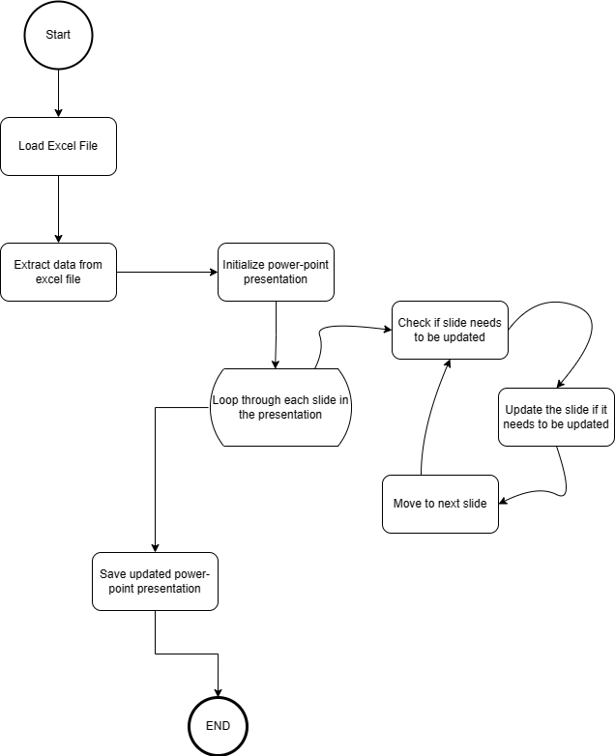
Detailed flowchart

Slide 6
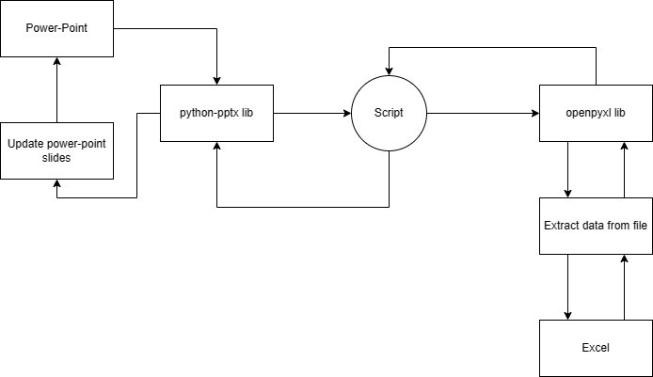
DATA FLOW DIAGRAM

Slide 7
Proof of functionality

Slide 8
Technologies used
Python.
VS Code / PyCharm as IDE .
Openpyxl library for excel and python connection.
Python-pptx library for power-point and python connection.

Slide 9
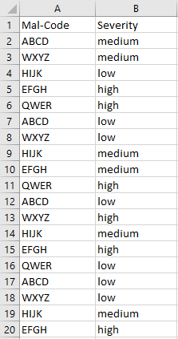
Original data

Slide 10
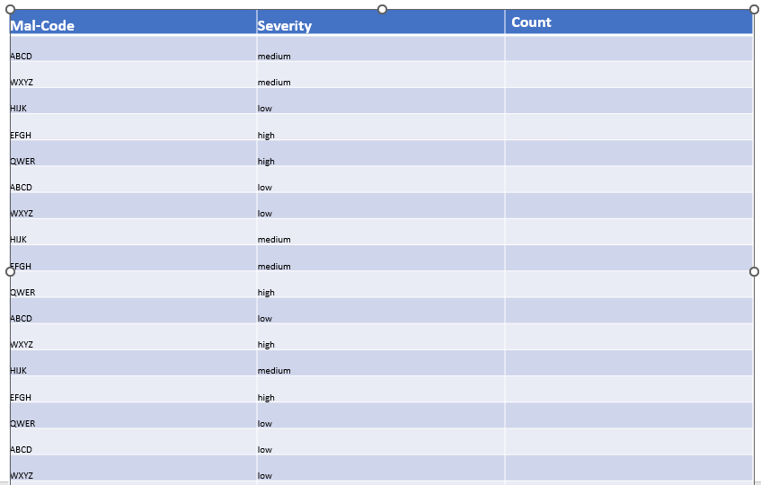
table in power-point

Slide 11
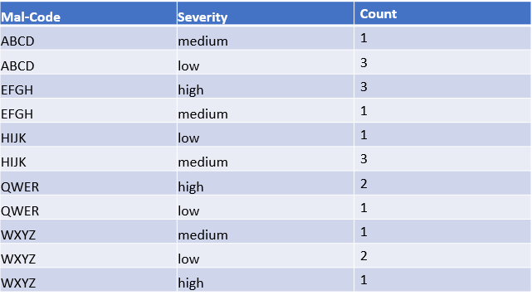
Updated table

Slide 12
SUMMARY
The automation script is a new project aimed to eliminate the current system where the users need to manually update the data in the power-point presentation whenever there are changes in the excel data making it time and energy consuming. This automation script will help in carrying out this tedious operation efficiently and automatically saving both time and energy.

Slide 13
THANK YOU
Rounak Kalbhawar
2603315

